Slide 1
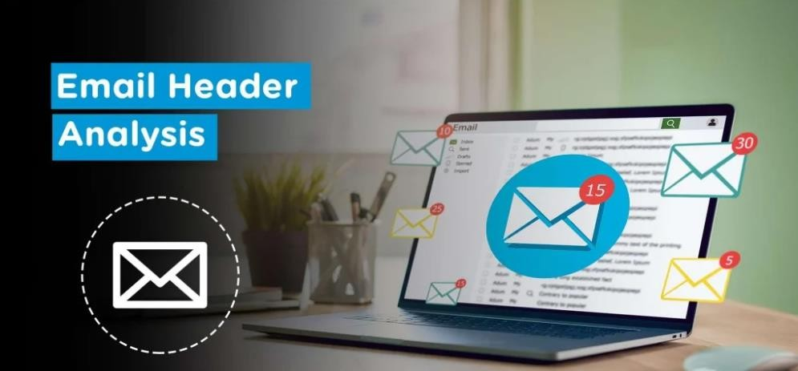
Phishing- Email Analysis

Slide 2
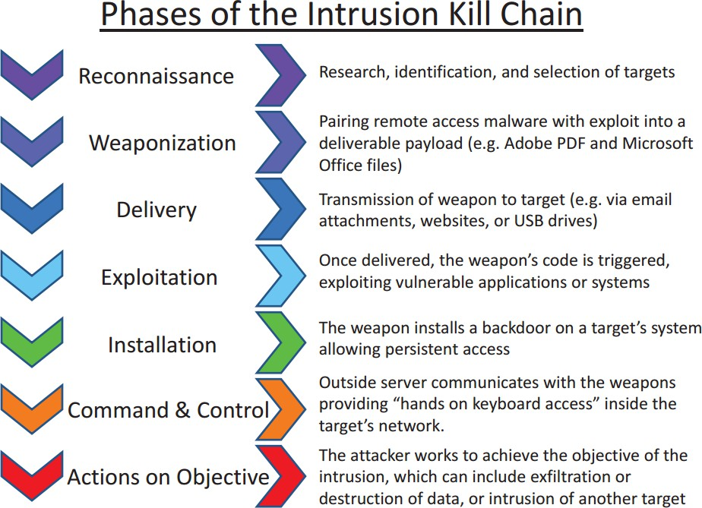
Introduction to Phishing
Phishing attack is a type of attack aimed at stealing personal data of the user in general by clicking on malicious links to the users via email or running malicious files on their computer.
Phishing attacks correspond to the "Delivery" phase in the Cyber Kill Chain model created to analyze cyber- attacks. The delivery stage is the step where the attacker transmits the previously prepared harmful content to the victim systems / people.
The Phishing attack is the most common attack vector for initial access. Of course, the only purpose of the attack is not to steal the user's password information.
The purpose of such attacks is to exploit the human factor, the weakest link in the chain. Attackers use phishing attacks as the first step to infiltrate systems.

Slide 3
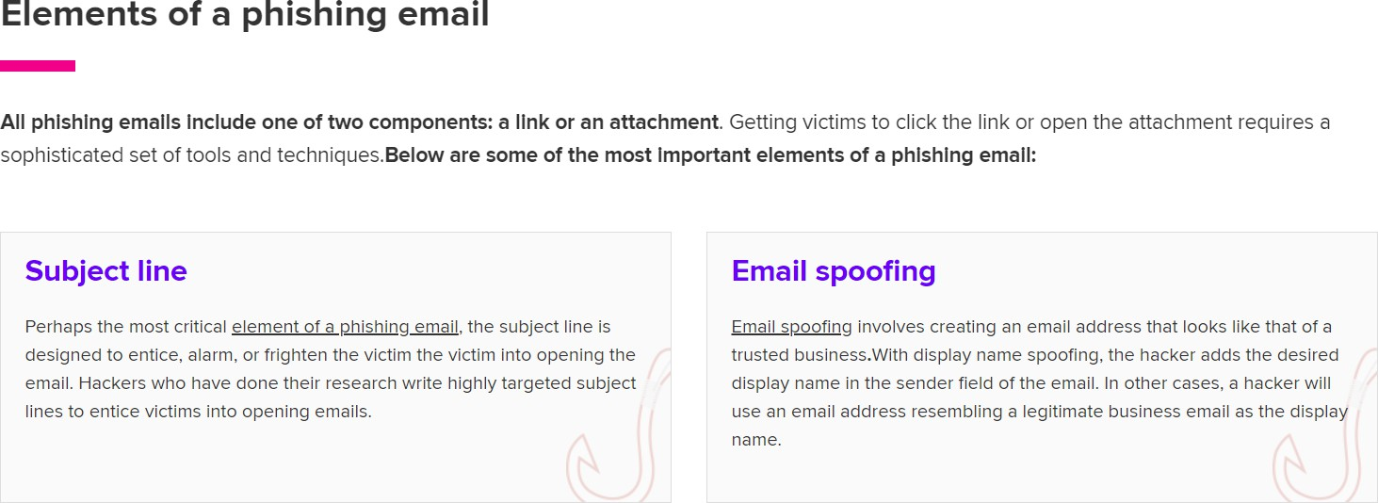
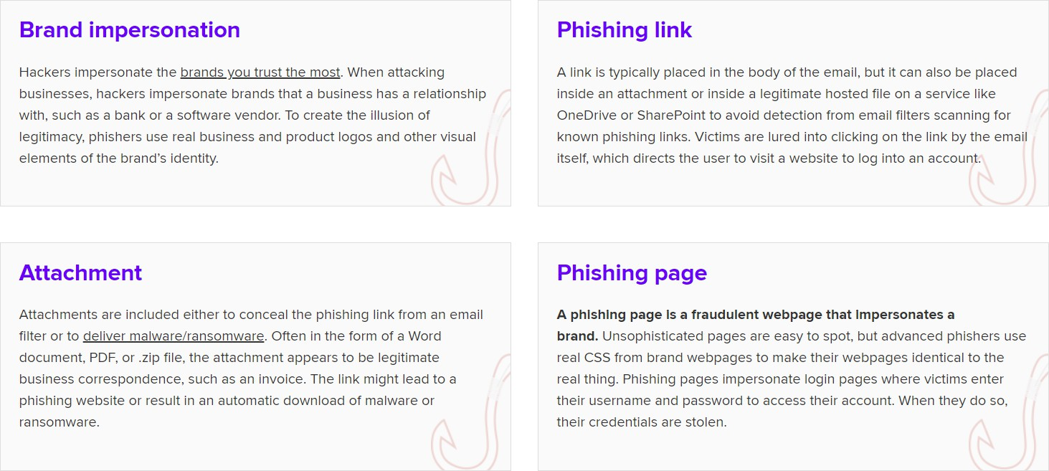
What is phishing email analysis?
Phishing email analysis involves studying the content of phishing emails to ascertain the techniques the attacker used.
What is a common indicator of a phishing email?
Common indicators of a phishing email include suspicious addresses, links, or domain names, threatening language or a sense of urgency, errors in the email, the inclusion of suspicious attachments, and emails requesting sensitive information.

Slide 4
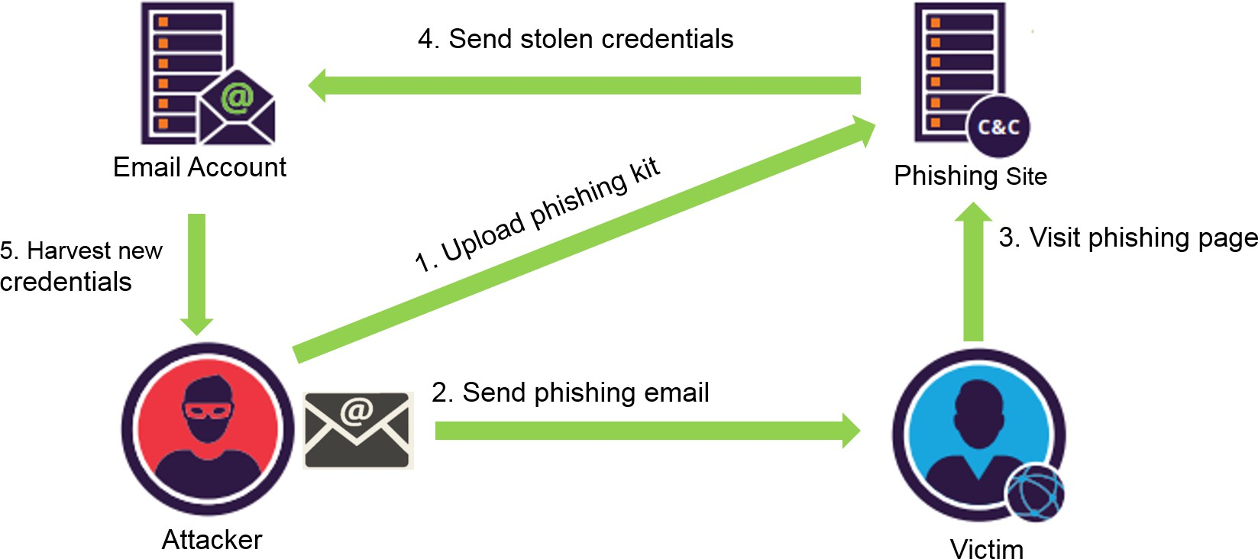
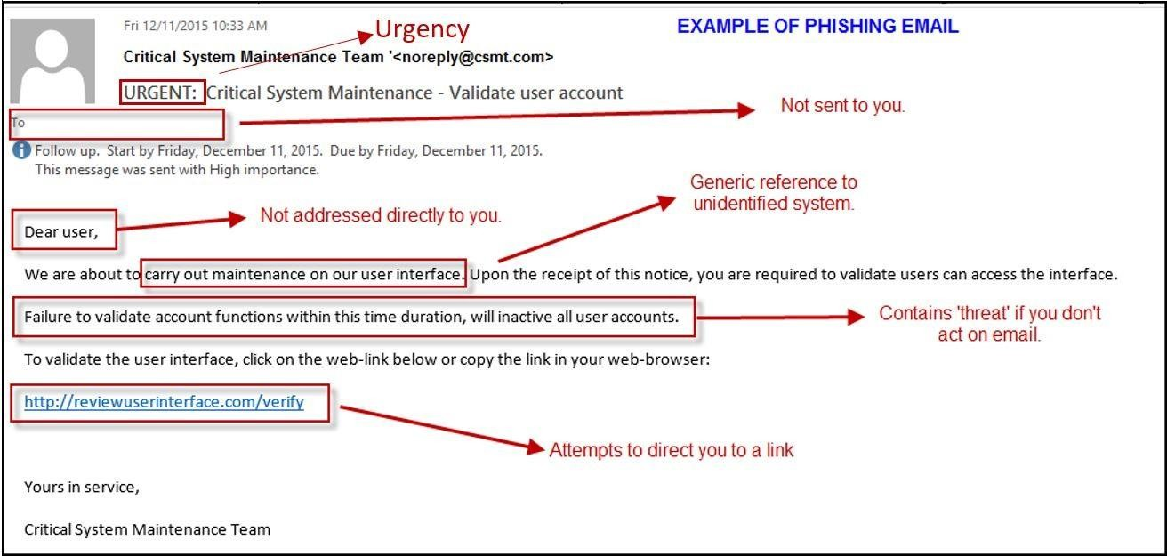
Phishing attack flow
EXAMPLE OF PHISHING EMAIL

Slide 5
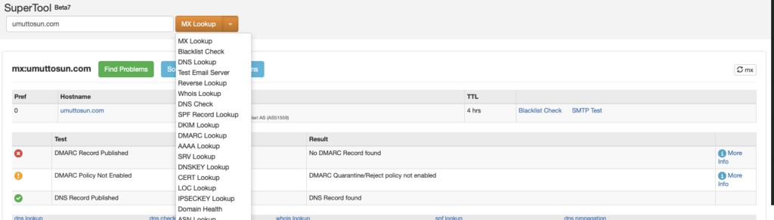
Information Gathering
Spoofing
Attackers can send emails on behalf of someone else, as the emails do not necessarily have an authentication mechanism. Attackers can send mail on behalf of someone else using the technique called spoofing to make the user believe that the incoming email is reliable.
Several protocols have been created to prevent the Email Spoofing technique. With the help of SPF, DKIM and DMARC protocols, it can be understood whether the sender's address is fake or real. Some mail applications do these checks automatically. However, the use of these protocols is not mandatory and in some cases can cause problems.
Sender Policy Framework (SPF)
DomainKeys Identified Mail (DKIM)
To find out manually whether the mail is spoof or not, SMTP address of the mail should be learned first. SPF, DKIM, DMARC and MX records of the domain can be learned using tools such as Mxtoolbox. By comparing the information here, it can be learned whether the mail is spoof or not.
Since the IP addresses of the big institutions using their own mail servers will belong to them, it can be examined whether the SMTP address belongs to that institution by looking at the whois records of the SMTP IP address.
An important point here is that if the sender address is not spoof, we cannot say mail is safe. Harmful mails can be sent on behalf of trusted persons by hacking corporate / personal email addresses. This type of cyber attacks has already happened, so this possibility should always be considered.

Slide 6
E-mail Traffic Analysis
Many parameters are needed when analyzing a phishing attack. We can learn the size of the attack and the target audience in the search results to be made on the mail gateway according to the following parameters.
Sender Address
SMTP IP Address
Email Address Domain
Subject (sender address and SMTP address may be constantly changing).
In the search results, it is necessary to learn the recipient addresses and time information besides the mail numbers.
If harmful e-mails are constantly forwarded to the same users, their e-mail addresses may have leaked in some way and shared on sites such as PasteBin.
Attackers can find email addresses with theHarvester tool on Kali Linux. It is recommended that such information should not be shared explicitly, as keeping personal mail addresses on websites would be a potential attack vector for attackers.
If mails are sent out of working hours, the attacker may be living on a different time-zone line. By gathering such information, we can begin to make sense of the attack.
What is an Email Header and How to Read Them?
In this section, we will explain what the header information in an email is, what can be done with this information and how to access this information. It is important to follow this section carefully as we will explain how to perform the header analysis in the next section.

Slide 7
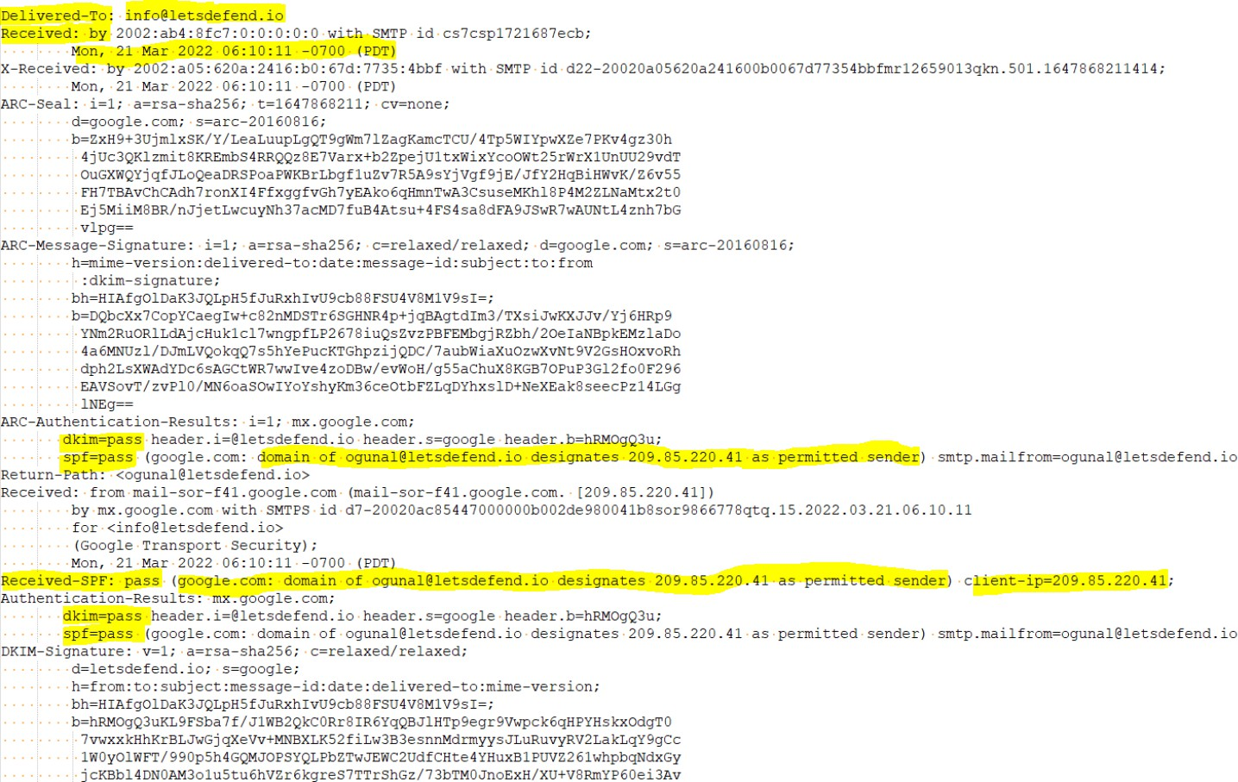

What is an Email Header?
"Header" is basically a section of the mail that contains information such as sender, recipient and date. In addition, there are fields such as "Return-Path", "Reply-To", and "Received". Below you can see the header details of a sample email.
What does the Email Header do?
A. Enables Shipper and Recipient Identification
Thanks to the "From" and "To" fields in the header, it is determined from whom an email will go to whom. If we look at the email above that you downloaded in "eml" format, we see that it was sent from the address ogunal@letsdefend.io to info@letsdefend.io

Slide 8
B. Spam Blocker
It is possible to detect spam emails using Header analysis and other various methods. This protects people from receiving SPAM emails.
C. Allows Tracking an Email’s Route
It is important to check the route it follows to see if an email came from the right address. If we look at the sample email above, we see that it came from the ogunal@letsdefend.io address, but did it actually come from the letsdefend.io domain or from a different fake server that mimics the same name? We can use the header information to answer this question.
Important Email Header Fields
From
The "From" field in the internet header indicates the name and email address of the sender.
To
This field in the mail header contains the email's receiver's details.
It includes their name and their email address. Fields like CC (carbon copy) and BCC (blind carbon copy) also fall under this category as they all include details of your recipients.
If you want to find out more about carbon copy and blind carbon copy, check out how to use CC and BCC.
Date
This is the timestamp that shows when the email was sent.
In Gmail, it usually follows the format of "day dd month yyyy hh:mmss
So if an email had been sent on the 16th of November, 2021, at 4:57:23 PM, it would show as Wed, 16 Nov 2021 16:57:23.
Subject
The subject mentions the topic of the email. It summarizes the content of the entire message body.
Return-Path
This mail header field is also known as Reply-To. If you reply to an email, it will go to the address mentioned in the Return-Path field.
Domain Key and DKIM Signatures
The Domain Key and Domain Key Identified Mail (DKIM) are email signatures that help email service providers identify and authenticate your emails, similar to SPF signatures.

Slide 9
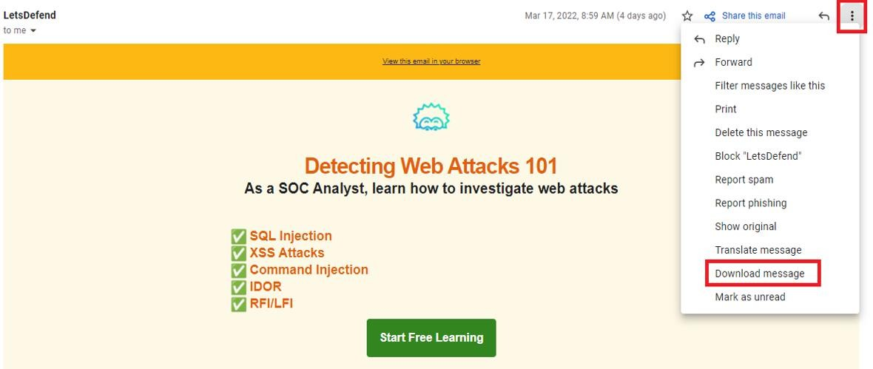
Message-ID
The Message ID header field is a unique combination of letters and numbers that identifies each mail. No two emails will have the same Message ID.
MIME-Version
Multipurpose Internet Mail Extensions (MIME) is an internet standard of encoding. It converts non-text content like images, videos, and other attachments into text so they can be attached to an email and sent through SMTP (Simple Mail Transfer Protocol).
Received
The received field lists each mail server that went through an email before arriving in the recipient's inbox. It's listed in reverse chronological order — where the mail server on the top is the last server the email message went through, and the bottom is where the email originated.
Spam Status
The X-Spam Status shows you the spam score of an email message.
First, it'll highlight if a message is classified as spam.
Then, the spam score of the email is shown, as well as the threshold for the spam for the email.
An email can meet either the spam threshold of an inbox or exceed it. If it's too spammy and exceeds the threshold, it will automatically be classified as spam and sent to the spam folder.
Reference of Field Definitions: gmass.co
How to Access Your Email Header?
Gmail
Open the relevant e-mail
Click on the 3 points at the top right "..."
Click on the "Download message" button.

Slide 10
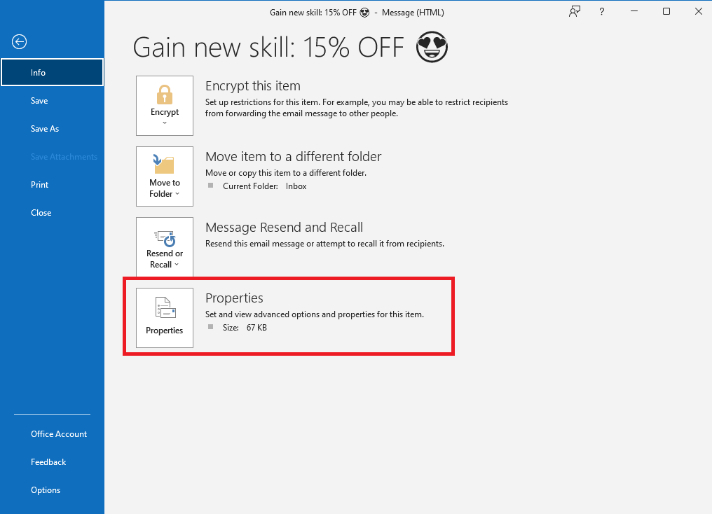
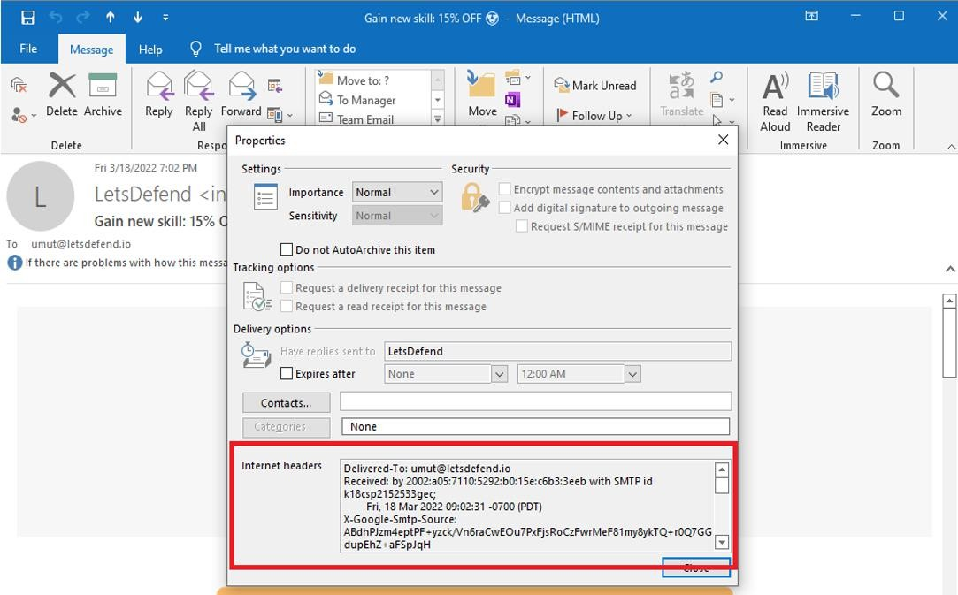
4- Downloaded ".Open the file with the extension "eml" with any notebook application
Outlook
Open the relevant e-mail
File - > Info -> Properties - > Internet headers

Slide 11
EMAIL HEADER ANALYSIS LAB
Course Files
Filename: Challenge Mail
Size: 7,45 KB
Password: infected
Download link: https://app.letsdefend.io/download/downloadfile/Challenge%20Mail.zip
Practice Questions
Download the email above, if we want to answer this email, what would the recipient’s address be?
What year was the email sent?
What is the Message-ID value? (without > < )
SAMPLE EMAIL HEADER
Delivered-To: ogunal@letsdefend.io
Received: by 2002:a05:6400:159:0:0:0:0 with SMTP id hw25csp1949486ecb; Mon, 21 Mar 2022 13:45:24 -0700 (PDT)
X-Google-Smtp-Source: ABdhPJzA6syR+DNCl4k2HAsTVGRMTuZ8qBPoI7WZhdA2aQRebfOMIA6xySOrt/bkng1NaGtoG3CB X-Received: by 2002:a25:1344:0:b0:633:7592:9c0f with SMTP id 65- 20020a251344000000b0063375929c0fmr24595651ybt.211.1647895524591; Mon, 21 Mar 2022 13:45:24 -0700 (PDT)
ARC-Authentication-Results: i=1; mx.google.com;
dkim=pass header.i=@mailchimpapp.net header.s=k3 header.b=LDGOzGog;
spf=pass (google.com: domain of bounce-mc.us14_171215441.8996217-675c34a61f@mail41.suw13.rsgsv.net designates
198.2.183.41 as permitted sender)
smtp.mailfrom=bounce-mc.us14_171215441.8996217-675c34a61f@mail41.suw13.rsgsv.net
Return-Path: <bounce-mc.us14_171215441.8996217-675c34a61f@mail41.suw13.rsgsv.net>
Received: from mail41.suw13.rsgsv.net (mail41.suw13.rsgsv.net. [198.2.183.41])
by mx.google.com with ESMTPS id o5-20020a0dcc05000000b002e5bb9dca69si6996501ywd.242.2022.03.21.13.45.23
for <ogunal@letsdefend.io>
(version=TLS1_2 cipher=ECDHE-ECDSA-AES128-GCM-SHA256 bits=128/128); Mon, 21 Mar 2022 13:45:24 -0700 (PDT)
Received-SPF: pass (google.com: domain of bounce-mc.us14_171215441.8996217-675c34a61f@mail41.suw13.rsgsv.net
designates 198.2.183.41 as permitted sender) client-ip=198.2.183.41;
Authentication-Results: mx.google.com;
dkim=pass header.i=@mailchimpapp.net header.s=k3 header.b=LDGOzGog;
spf=pass (google.com: domain of bounce-mc.us14_171215441.8996217-675c34a61f@mail41.suw13.rsgsv.net designates
198.2.183.41 as permitted sender)
smtp.mailfrom=bounce-mc.us14_171215441.8996217-675c34a61f@mail41.suw13.rsgsv.net
Received: from localhost (localhost [127.0.0.1]) by mail41.suw13.rsgsv.net (Mailchimp) with ESMTP id 4KMmpW3vnnz9K82VW
for <ogunal@letsdefend.io>; Mon, 21 Mar 2022 20:45:23 +0000 (GMT
)
Subject: =?utf-8?Q?Top=203=20Blog=20posts=20for=20SOC=20teams=C2=A0=F0=9F=91=80?=

Slide 12
From: =?utf-8?Q?LetsDefend?= <info@letsdefend.io>
Reply-To: =?utf-8?Q?LetsDefend?= <info@letsdefend.io>
To: <ogunal@letsdefend.io>
Date: Mon, 21 Mar 2022 20:45:17 +0000
Message-ID: <74bda5edf824cea8aad36e707.675c34a61f.20220321204512.a02caaccf3.a268ce5a@mail41.suw13.rsgsv.net>
MIME-Version: 1.0
Email Header Analysis
In previous sections we talked about what a phishing email is, what header information is and what it does. Now, when we suspect that an email is phishing, we will know what we should do and what the analysis process should be like.
Here are the key questions we need to answer when checking headings during a Phishing analysis:
Was the email sent from the correct SMTP server?
Are the data "From" and "Return-Path / Reply-To" the same?
The e-mail examined in the rest of the article:
password: infected
Download Link: https://drive.google.com/file/d/1x4BQF9zdR2l913elSQtixb-kmi9Jan_6/view
A. Was the email sent from the correct SMTP server?
We can check the "Received" field to see the path followed by the mail. As the image below shows, the mail is
"101[.]99.94.116"
from the IP address server.
If we look at who is sending the mail ("sender"), we see that it came from the domain Letsdefend.io
So under normal circumstances, "letsdefend.io" should use, "101[.]99.94.116" to send mail. To confirm this situation, We can query the MX servers actively used by "letsdefend.io"

Slide 13
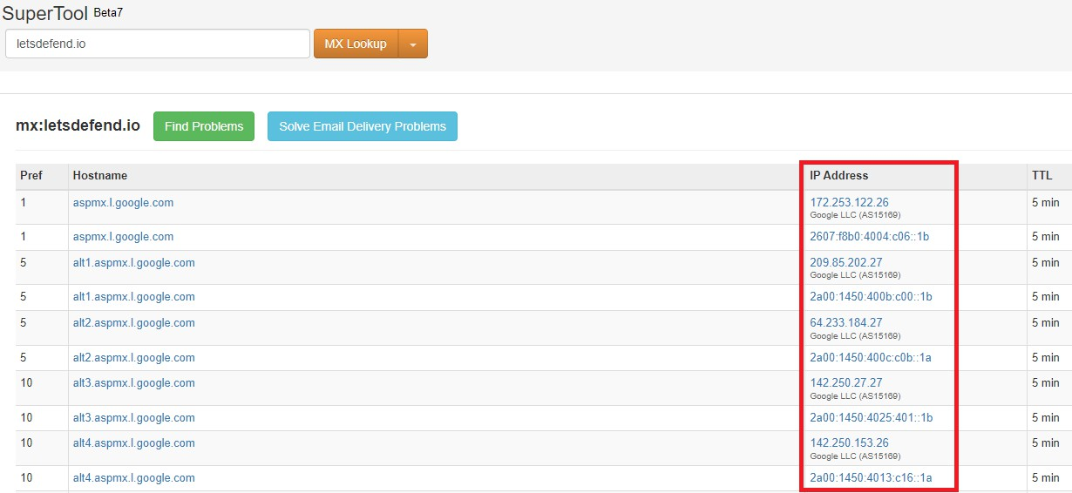
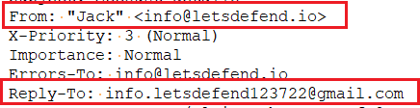
"mxtoolbox.com"
helps by showing you the MX servers used by the domain you searched.
If we look at the image above, the "letsdefend.io" domain uses Google addresses as an email server. So there is no relationship with the emkei[.]cz or "101[.]99.94.116" addresses.
In this check, it was determined that the email did not come from the original address, but was spoofed.
B. Are the data "From" and "Return-Path / Reply-To" the same?
Except in exceptional cases, we expect the sender of the e-mail and the person receiving the responses to be the same. An example of why these areas are used differently in Phishing attacks:
Returning to the e-mail we downloaded above, all we have to do is compare the email addresses in the "From" and "Reply-to" fields.
As you can see, the data is different. In other words, when we want to reply to this e-mail, we will send a reply to the gmail address below. Just because this data is different doesn't always mean it's definitely a phishing email, we need to consider the event as a whole. In other words, in addition to this suspicious situation, if there is a harmful attachment, URL or misleading content in the e-mail content, we can understand that the e-mail is phishing.

Slide 14

Course Files
Filename: Header Challenge
Size: 2,69 KB
Password: infected
Download: https://drive.google.com/file/d/1x4BQF9zdR2l913elSQtixb-kmi9Jan_6/view
LAB Questions
If I want to reply to this email, which address will it be sent to?
open the email with text editor and check the reply-to field
From which IP address was the email sent?
check the email fields
Download the email above ("Header Challenge"), are the sender’s address and the address in the “Reply-To” area
check from and reply-to fields
Static Analysis
It is a fact that mails composed of plain text are boring. For this reason, mail applications provide HTML support, allowing the creation of mails that can attract more attention of users. Of course, this feature has a disadvantage. Attackers can create e-mails with HTML, hiding URL addresses that are harmful behind buttons / texts that seem harmless.
As seen in the image above, the address that the user sees can be different when the link is clicked (the real address is seen when the link is hovered).
Attackers take a new domain address in most phishing attacks and do a phishing attack within a few days and finish their work. For this reason, if the domain name in the mail is new, it is more likely to be a phishing attack.
It is possible to find out whether the antivirus engines detect the web address as harmful by searching the web addresses in the mail on VirusTotal. If someone else has already analyzed the same address / file in VirusTotal, VirusTotal does not analyze from scratch, it shows you the old analysis result. We can use this feature both as an advantage and a disadvantage.

Slide 15
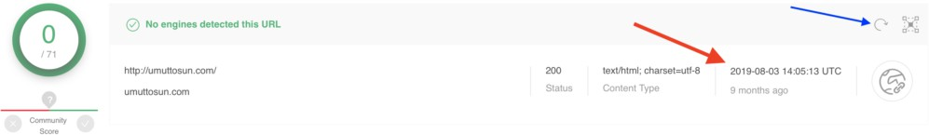
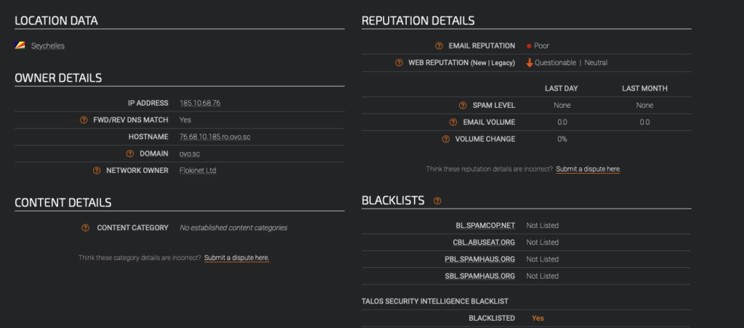
If the attacker searches the domain address on VirusTotal without containing harmful content on it, that address will appear harmless on VirusTotal, and if it goes unnoticed, you may be mistaken for this address to be harmless.
In the image above, you can see that umuttosun.com address appears harmless, but if you look at the section marked with the red arrow, you will see that this address was searched 9 months ago, and this result is 9 months ago. To have it analyzed again, the button marked with the blue arrow must be pressed.
Performing static analysis of the files in the mail can enable the learning of the capacity / capabilities of that file. However, since static analysis takes a long time, you can get the information you need more quickly with dynamic analysis.
Cisco Talos Intelligence has search sections where we can learn reputations of IP addresses. By searching the SMTP address of the mail we detected on Talos, we can see the reputation of the IP address and find out whether it is included in the blacklist. If the SMTP address is in the blacklist, it can be understood that an attack was made on a compromised server.
Likewise, the SMTP address can be searched on VirusTotal and AbuseIPDB to determine if the IP address has previously been involved in malicious activities.

Slide 16
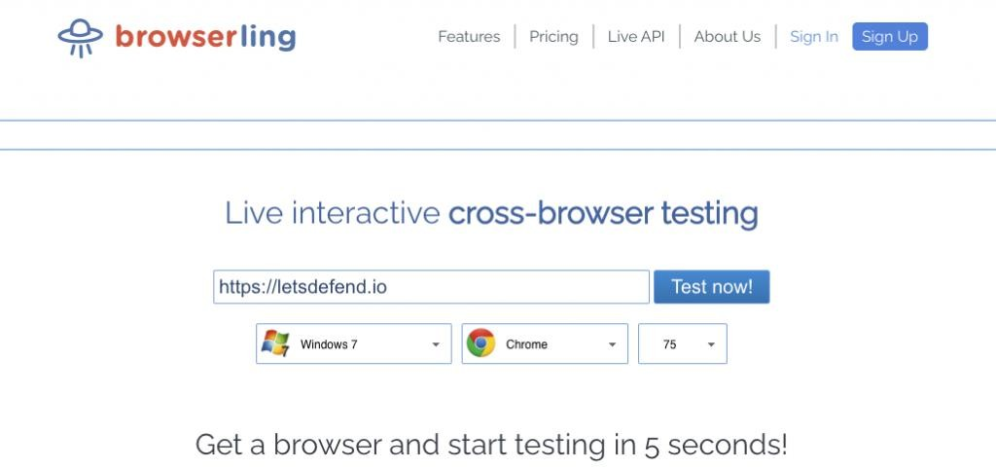
Dynamic Analysis
URLs and files can be found in the mail. These files and URL addresses need to be examined. You don't want your data to be stolen by hackers by running these files on your personal computer. For this reason, the websites and files in the mail should be run in sandbox environments and the changes made on the system should be examined, and it should be checked whether they are harmful or not.
If you want to quickly check the web addresses in the mail, you can see the content of the website using online web browsers such as Browserling. The good thing about such services is that you will not be affected by a possible zero-day vulnerability that affects browsers, since you do not go to the web page on your own computer.
The disadvantage of using web browsers such as Browserling is that if the malicious file is downloaded on the site, you cannot run this file. For this reason, your analysis will be interrupted.
Sandbox Environment for Email Header Analysis
You can examine suspicious files and websites in sandbox environments. When you examine the files in these environments, you remove the risk of infecting your computer with malware. Many sandbox services / products are available. These products / services are available for paid and free use. You can choose one / more of these services according to your needs.
A few commonly used sandboxes:
VMRay
Cuckoo Sandbox
JoeSandbox
AnyRun
Hybrid Analysis(Falcon Sandbox)

Slide 17
NOTE
Malware can wait for a certain period of time without any action to make detection difficult. You must wait for the malware to work before you decide that the examined file is not harmful.
The fact that there are no urls and files in the mail does not mean that this is not harmful. The attacker can also send it as a picture so as not to get caught up in the analysis products
Additional Techniques
Another technique that attackers use is to perform phishing attacks using normally legal sites. Some of them are as follows.
Using services that offer Cloud Storage services such as Google and Microsoft
Attackers try to click on Google / Microsoft drive addresses that seem harmless to the user by uploading harmful files onto the drive.
Using services that allow creating free subdomains such as Microsoft, Wordpress, Blogspot, Wix
Attackers try to deceive security products and analysts by creating a free subdomain from these services. Since whois information cannot be searched as a subdomain, it can be seen that these addresses were taken in the past and belongs to institutions such as Microsoft, WordPress.
Form applications
Services are available that allow free form creation. Attackers use these services instead of creating a fishing site themselves. Since the domain is harmless under normal conditions, it can pass on to the user without getting stuck on antivirus software. Google Form is an example of these services. When looking at whois information, the domain can be seen to be Google, so the attacker can mislead analysts.
Hand-on Practice Lab with SOC Alerts on LetsDefend Platform
93 - SOC146 - Phishing Mail Detected - Excel 4.0 Macros
82 - SOC140 - Phishing Mail Detected - Suspicious Task Scheduler
45 - SOC114 - Malicious Attachment Detected - Phishing Alert
52 - SOC120 - Phishing Mail Detected - Internal to Internal
86 - SOC141 - Phishing URL Detected

Slide 18

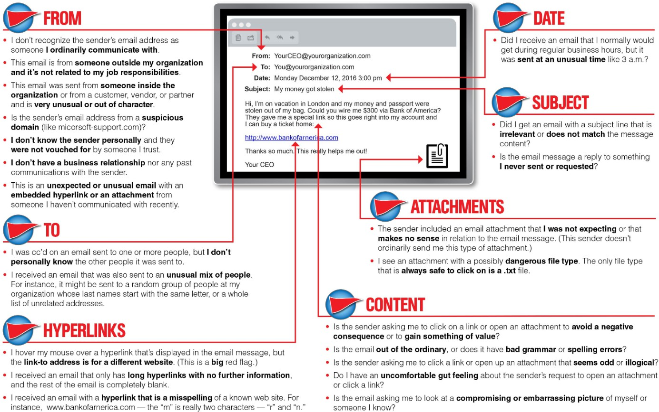
DEFENSIVE PROTECTIVE MEASURES
Some defensive layers to take into consideration to assist in preventing email phishing attacks and credential stealing
from phishing attacks would be:
Email scanning and filtering
Email security gateways
DNS authentication (DMARC, DKIM, and SPF)
Anti-malware and anti-spam
Multi-factor authentication (MFA)
Phishing security awareness

Slide 19
No matter how robust the email defensive layers are, phishing emails will find their way into a user’s mailbox. In the
end, the user is the last measure in these defensive protection layers, and they are only as strong as the effectiveness
of the phishing security awareness training provided by the organization.
REFERENCE
https://app.letsdefend.io/training/lessons/phishing-email-analysis
https://www.linkedin.com/pulse/phishing-email-simple-analysis-asif-ali/
https://www.imperva.com/blog/our-analysis-of-1019-phishing-kits/

